Slide 1
Introduction To Matplotlib And Seaborn
Dipesh kumar Barai
M.Sc. In statistics, Visva Bharati university
Indian Cyber security solutions

Slide 2
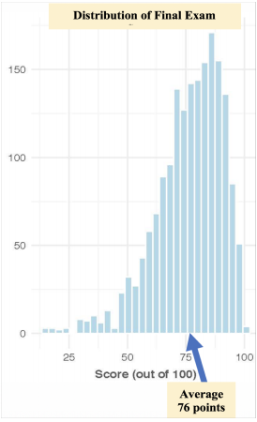
What is Statistics?
Methodological subject encompassing all aspects of learning from data. tools and methods for working with and understanding data.
Statisticians apply and develop data analysis methods, seek to understand their properties… …when do these tools provide insight? …when are they possibly misleading?
Researchers and workers apply and extend statistical methodology,
and contribute new ideas and methods for conducting data analysis.
A statistic ~ numerical or graphical summary of a collection of data.
A statistic ~ summary of a collection of data. ○ Average score on
final exam

Slide 3
Variable Types
Quantitative Variables
Numerical, measurable quantities in which arithmetic operations often make sense.
• Continuous – could take on any value within an interval, many possible values. Ex- Height, Weight.
• Discrete – countable value, finite number of values.(Some set of countable values.)
Categorical (or Qualitative) Variables
Classifies individuals or items into different groups.
• Ordinal – groups have an order or ranking. (Junior, senior).
• Nominal – groups are merely names, no ranking.(

Slide 4
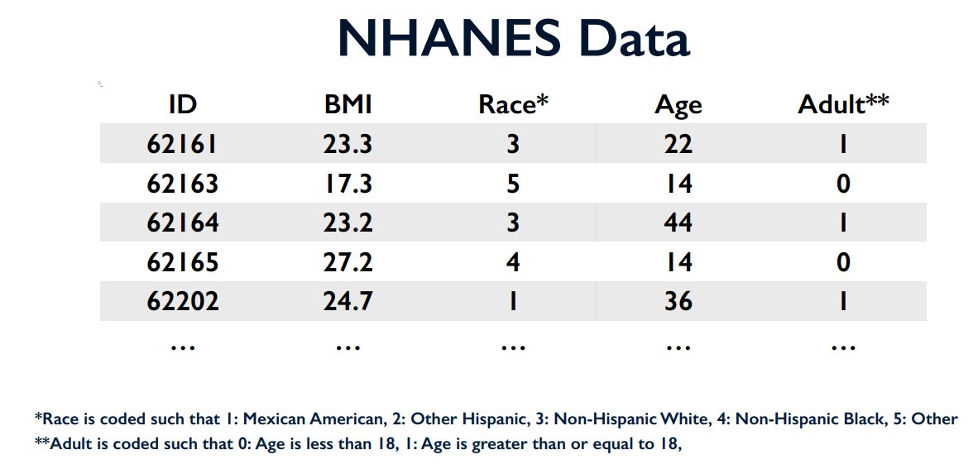
Medical Data National Health and Nutrition Examination

Slide 5
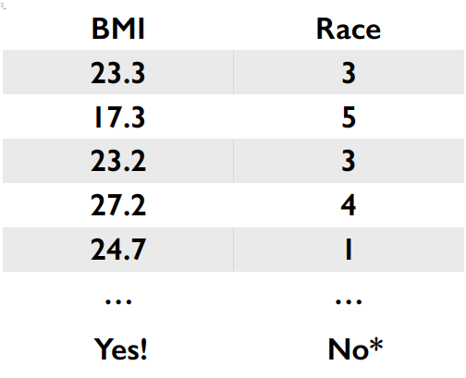
Think about It
Could we reasonably compute the average response for each of these two variables?

Slide 6
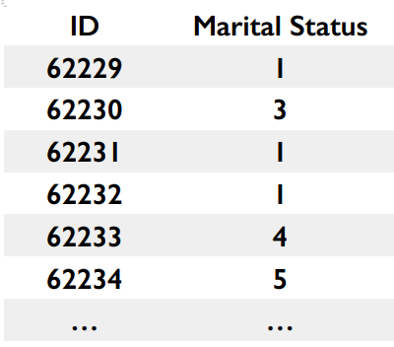
Categorical Data
Classifies individuals or items into different groups
*Marital Status is coded such that… 1: Married, 2: Widowed, 3: Divorced, 4: Separated, 5: Never Married, 6: Living with Partner, 7: Refused, 8: Don’t Know

Slide 7
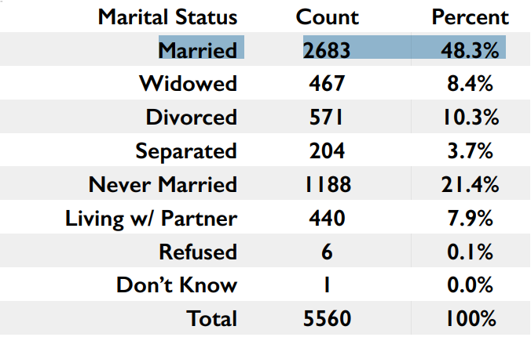
Frequency Table
Counts
Percentages

Slide 8
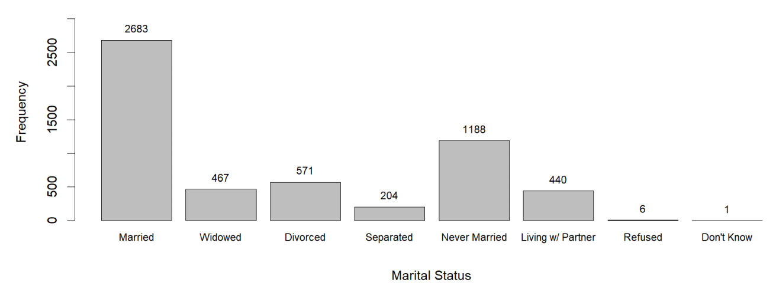
Bar Chart of Marital Status

Slide 9
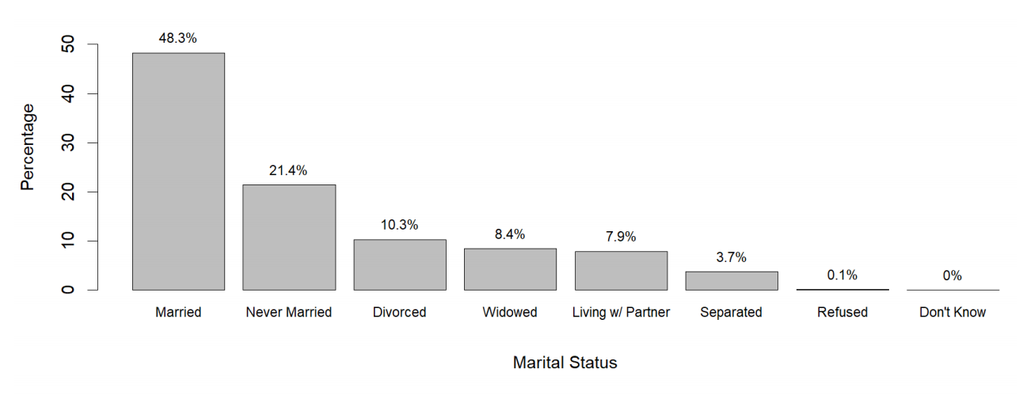
Bar Chart of Marital Status

Slide 10
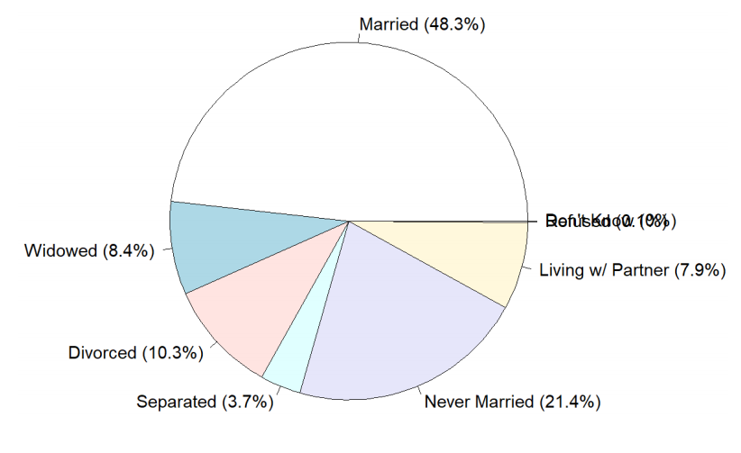
Pie Chart of Marital Status

Slide 11
Categorical Data
Frequency Tables
– Great for numerical summaries
Bar Charts
– Great for visualization
Pie Charts
– Use with caution

Slide 12
Quantitative Data: Histograms
What are Quantitative Variables?
Variables that have a numerical value (quantity) that we can perform mathematical operations on.
Examples: Height, weight, income, test scores, shoe size, number of “heads” after 10 coin flips

Slide 13
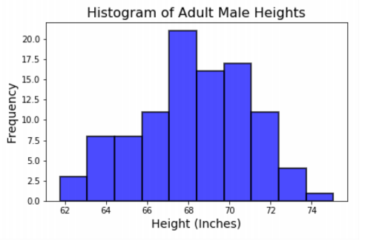
Adult Male Heights
Shape
Overall appearance of histogram. Can be symmetric, bell-shaped, left skewed, right skewed, etc.
Center
Mean or Median
Spread
How far our data spreads. Range, Interquartile Range (IQR), standard deviation, variance.
Outliers
Data points that fall far from the bulk of the data
The distribution of adult male heights is roughly bell shaped with a center of about 68 inches, a range of 13 inches (62 to 75), and no apparent outliers.

Slide 14
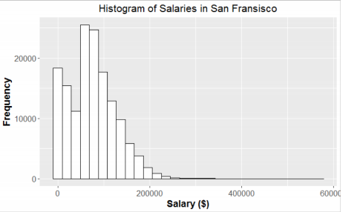
Salaries in San Francisco (2011-2014)
The distribution of salaries in San Francisco is bimodal and skewed to the right, centered at about $80,000 with most of the data between $40,000 and $120,000, a range of roughly $600,000, and outliers are present on the higher end.

Slide 15
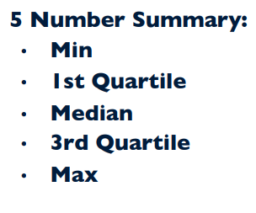
Numerical Summaries
(also called summary statistics) are used alongside our graphical representation of data to give a first impression of what our data looks like.

Slide 16
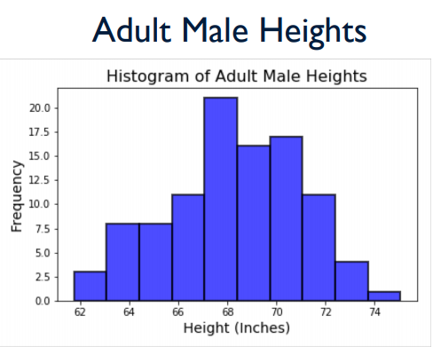
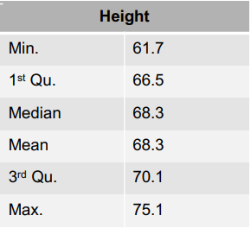
Numerical Summaries

Slide 17
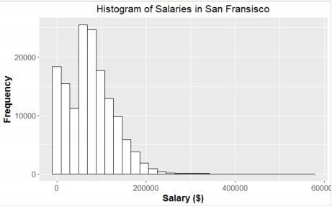
Salaries in San Francisco (2011-2014)

Slide 18
Quantitative Data Graphical Summary: Boxplots
Boxplots provide a graphical picture of the five-number summary: showing center (median), spread (IQR and range), and identifies potential outliers.
Boxplots can hide some shape aspects (histograms do better job at displaying shape)
Side-by-Side Boxplots are useful for comparing two or more sets of observations.

Slide 19
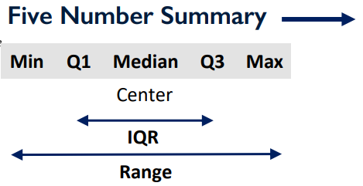
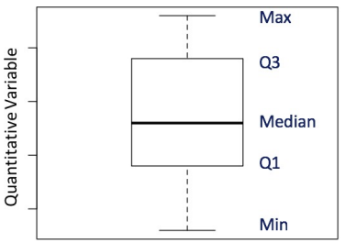
What is a Boxplot?

Slide 20
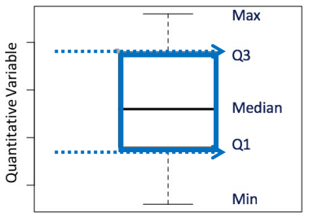
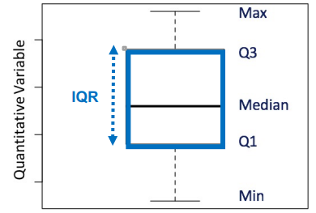
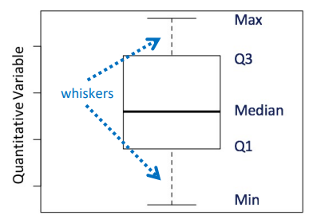
What is a Boxplot?
1St & 3rd Quartile
Inter Quartile Range
Whisker

Slide 21
Visualization with Matplotlib
We’ll now take an in-depth look at the Matplotlib tool for visualization in Python. Matplotlib is a multiplatform data visualization library built on NumPy arrays, and designed to work with the broader SciPy stack. It was conceived by John Hunter in 2002, originally as a patch to IPython for enabling interactive MATLAB-style plotting via gnu plot from the IPython command line.
Importing matplotlib
Just as we use the np shorthand for NumPy and the pd shorthand for Pandas, we will use some standard shorthands for Matplotlib imports:
import matplotlib as mpl
import matplotlib.pyplot as plt

Slide 22
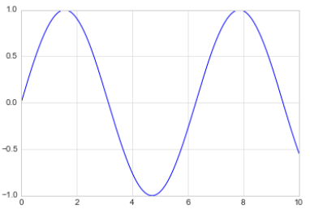
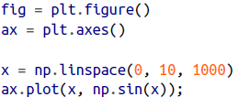
Setting Styles
We will use the plt.style directive to choose appropriate aesthetic styles for our figures.
Here we will set the classic style, which ensures that the plots we create use the
classic Matplotlib style:
plt.style.use('classic')

Slide 23
Scatter Plots with plt.scatter A second, more powerful method of creating scatter plots is the plt.scatter function, which can be used very similarly to the plt.plot function

Slide 24
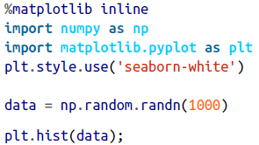
Histograms A simple histogram can be a great first step in understanding a dataset.

Slide 25

plt.subplot: Simple Grids of Subplots Aligned columns or rows of subplots are a common enough need that Matplotlib has several convenience routines that make them easy to create. The lowest level of these is plt.subplot(), which creates a single subplot within a grid. As you can see, this command takes three integer arguments—the number of rows, the number of columns, and the index of the plot to be created in this scheme, which runs from the upper left to the bottom right

Slide 26
Visualization with Seaborn Seaborn is a library for making statistical graphics in Python. It is built on top of matplotlib and closely integrated with pandas data structures. Seaborn aims to make visualization a central part of exploring and understanding data.
We import seaborn, which is the only library necessary for this simple example.
Import seaborn as sns

Slide 27
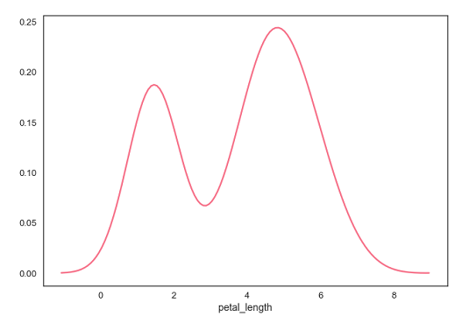
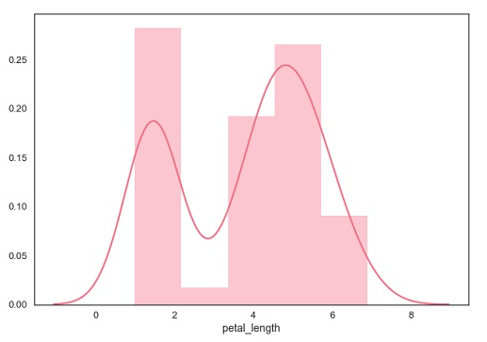
Seaborn - Kernel Density Estimates Kernel Density Estimation (KDE) is a way to estimate the probability density function of a continuous random variable. It is used for non-parametric analysis
Kernel Density Estimation
Fitting Parametric Distribution

Slide 28
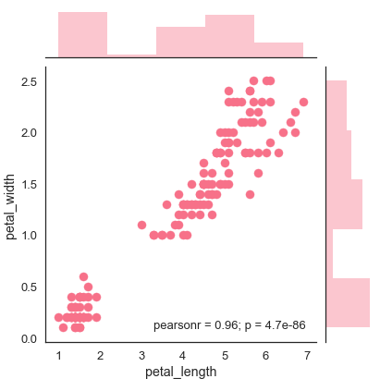
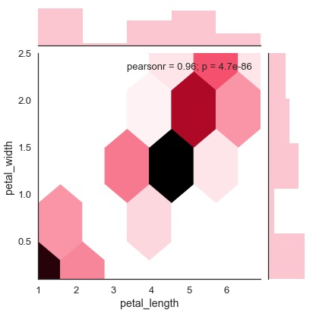
Visualization with Seaborn
Scatter Plot
Hexbin Plot
Scatter plot is the most convenient way to visualize the distribution where each observation is represented in two-dimensional plot via x and y axis.
Hexagonal binning is used in bivariate data analysis when the data is sparse in density i.e., when the data is very scattered and difficult to analyze through scatterplots.

Slide 29
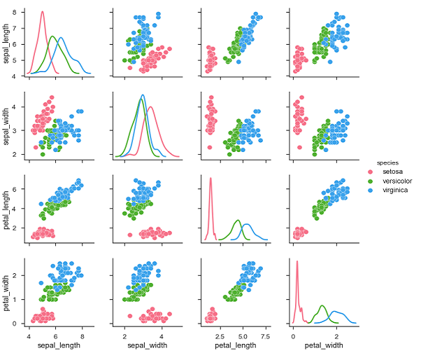
Visualizing Pairwise Relationship To plot multiple pairwise bivariate distributions in a dataset, you can use the pairplot() function. This shows the relationship for (n,2) combination of variable in a DataFrame as a matrix of plots and the diagonal plots are the univariate plots.
Parameter & Description
Data
Dataframe
hue
Variable in data to map plot aspects to different colors.
palette
Set of colors for mapping the hue variable.
kind
Kind of plot for the non-identity relationships. {‘scatter’, ‘reg’}
diag_kind
Kind of plot for the diagonal subplots. {‘hist’, ‘kde’}

Slide 30
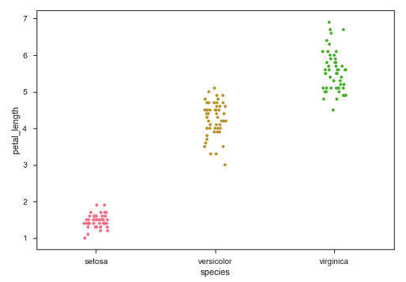
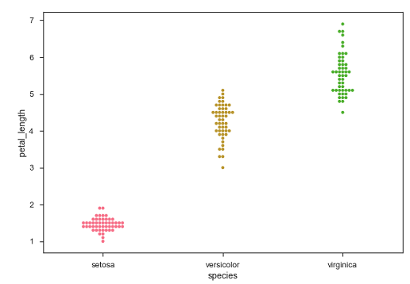
Plotting Categorical Data When one or both the variables under study are categorical, we use plots like striplot(), swarmplot(), etc,. Seaborn provides interface to do so.
stripplot()
Swarmplot()
stripplot() is used when one of the variable under study is categorical. It represents the data in sorted order along any one of the axis.
This function positions each point of scatter plot on the categorical axis and thereby avoids overlapping points.

Slide 31
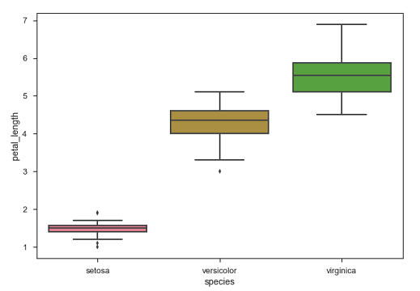
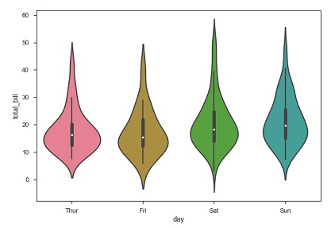
Distribution of Observations
Box Plots
Violin Plots
Boxplot is a convenient way to visualize the distribution of data through their quartiles
Violin Plots are a combination of the box plot with the kernel density estimates.

Slide 32
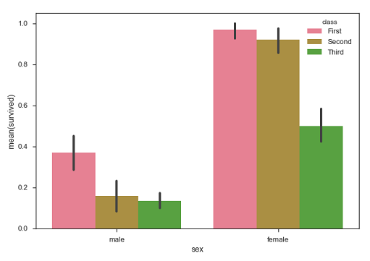
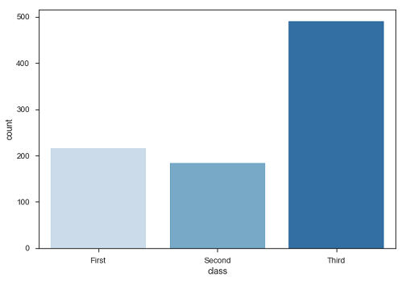
Statistical Estimation
Bar Plot
countplot()
The barplot() shows the relation between a categorical variable and a continuous variable
A special case in barplot is to show the no of observations in each category rather than computing a statistic for a second variable.

Slide 33
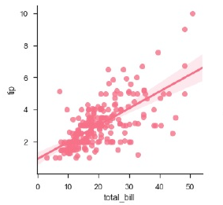
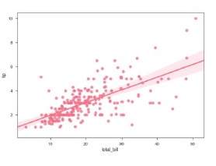
Linear Relationships There are two main functions in Seaborn to visualize a linear relationship determined through regression. These functions are regplot() and lmplot()
regplot()
lmplot()
accepts the x and y variables in a variety of formats including simple numpy arrays, pandas Series objects
data as a required parameter and the x and y variables must be specified as strings.

Slide 34
Thanks

